Slide 1

Enterprise Software Development

Slide 2

Getting started with Cognitive Services
AI Hack Day Warm-up 2020

Slide 3






Jernej Kavka (JK)
Senior Software Architect at SSW
@Jernej_kavka
github.com/jernejk
jkdev.me
linkedin.com/in/jernejkavka/
.NET Core and EF Core dev at day
Cognitive Services and ML.NET dev at night

Slide 4

Table of Contents
Cognitive Services
Get started
Demos

Slide 5
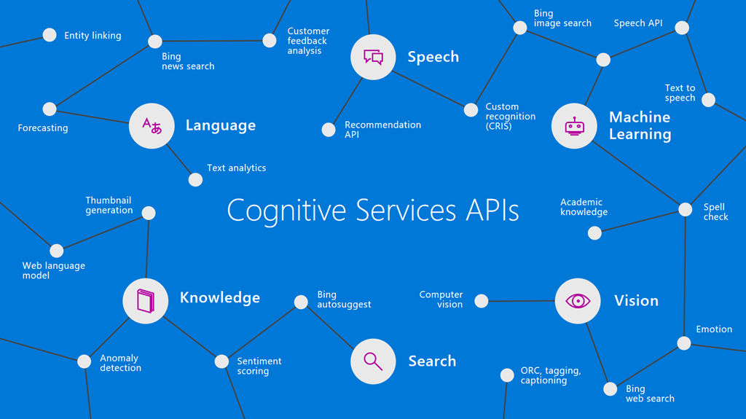

Slide 6
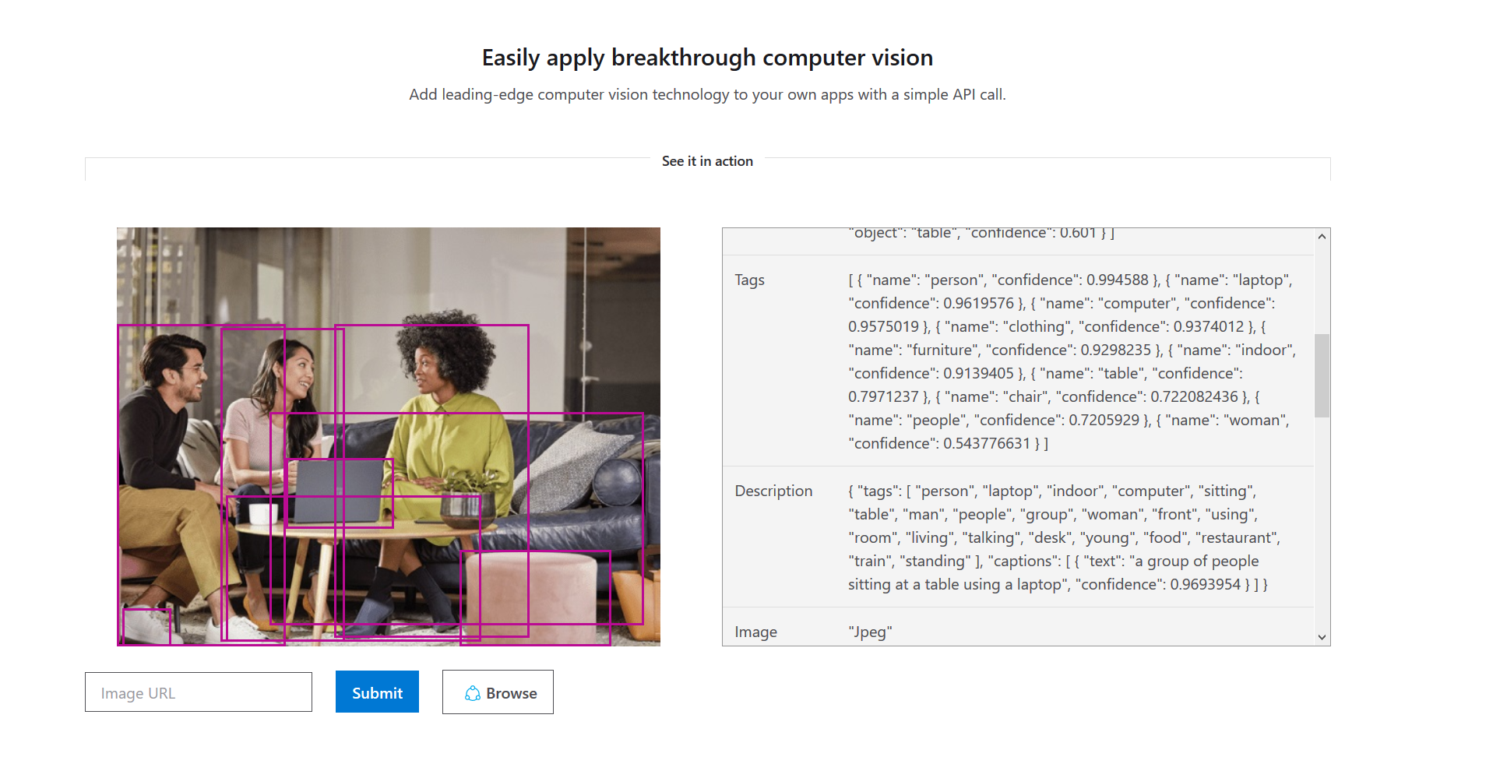

Slide 7
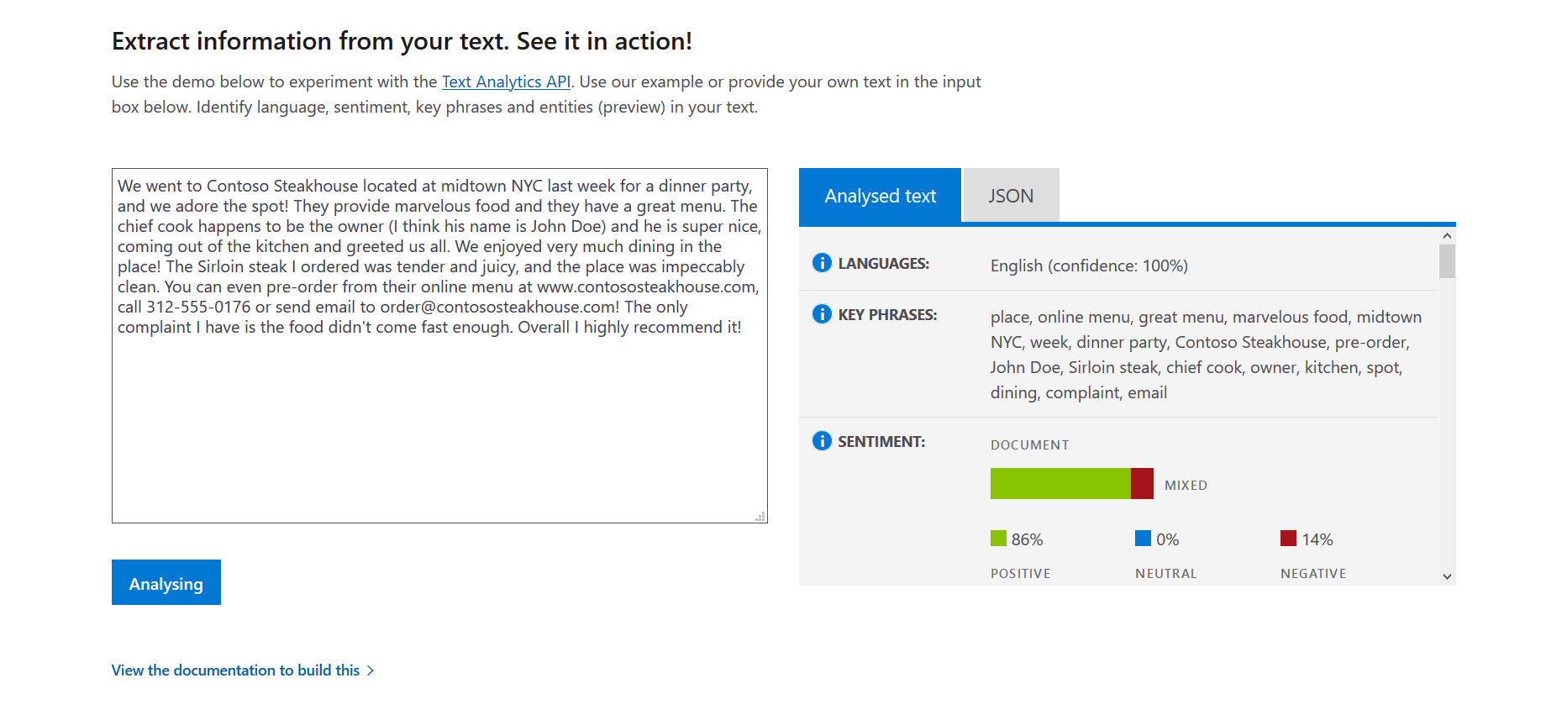

Slide 8
Table of Contents
Cognitive Services
Get started
Demos

Slide 9
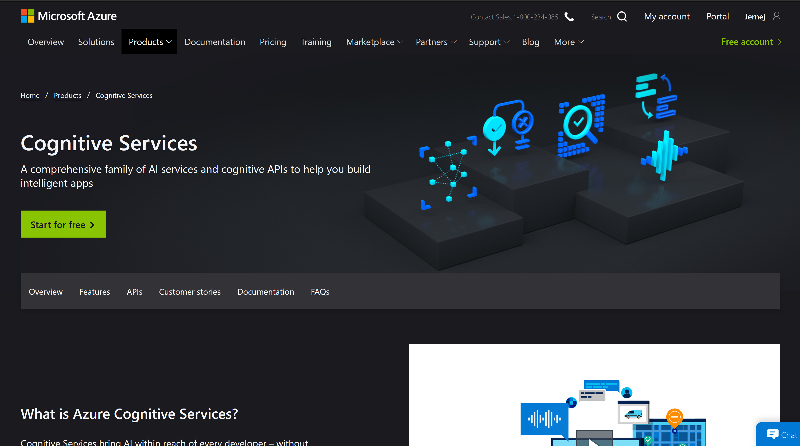
https://azure.microsoft.com/en-au/services/cognitive-services/

Slide 10
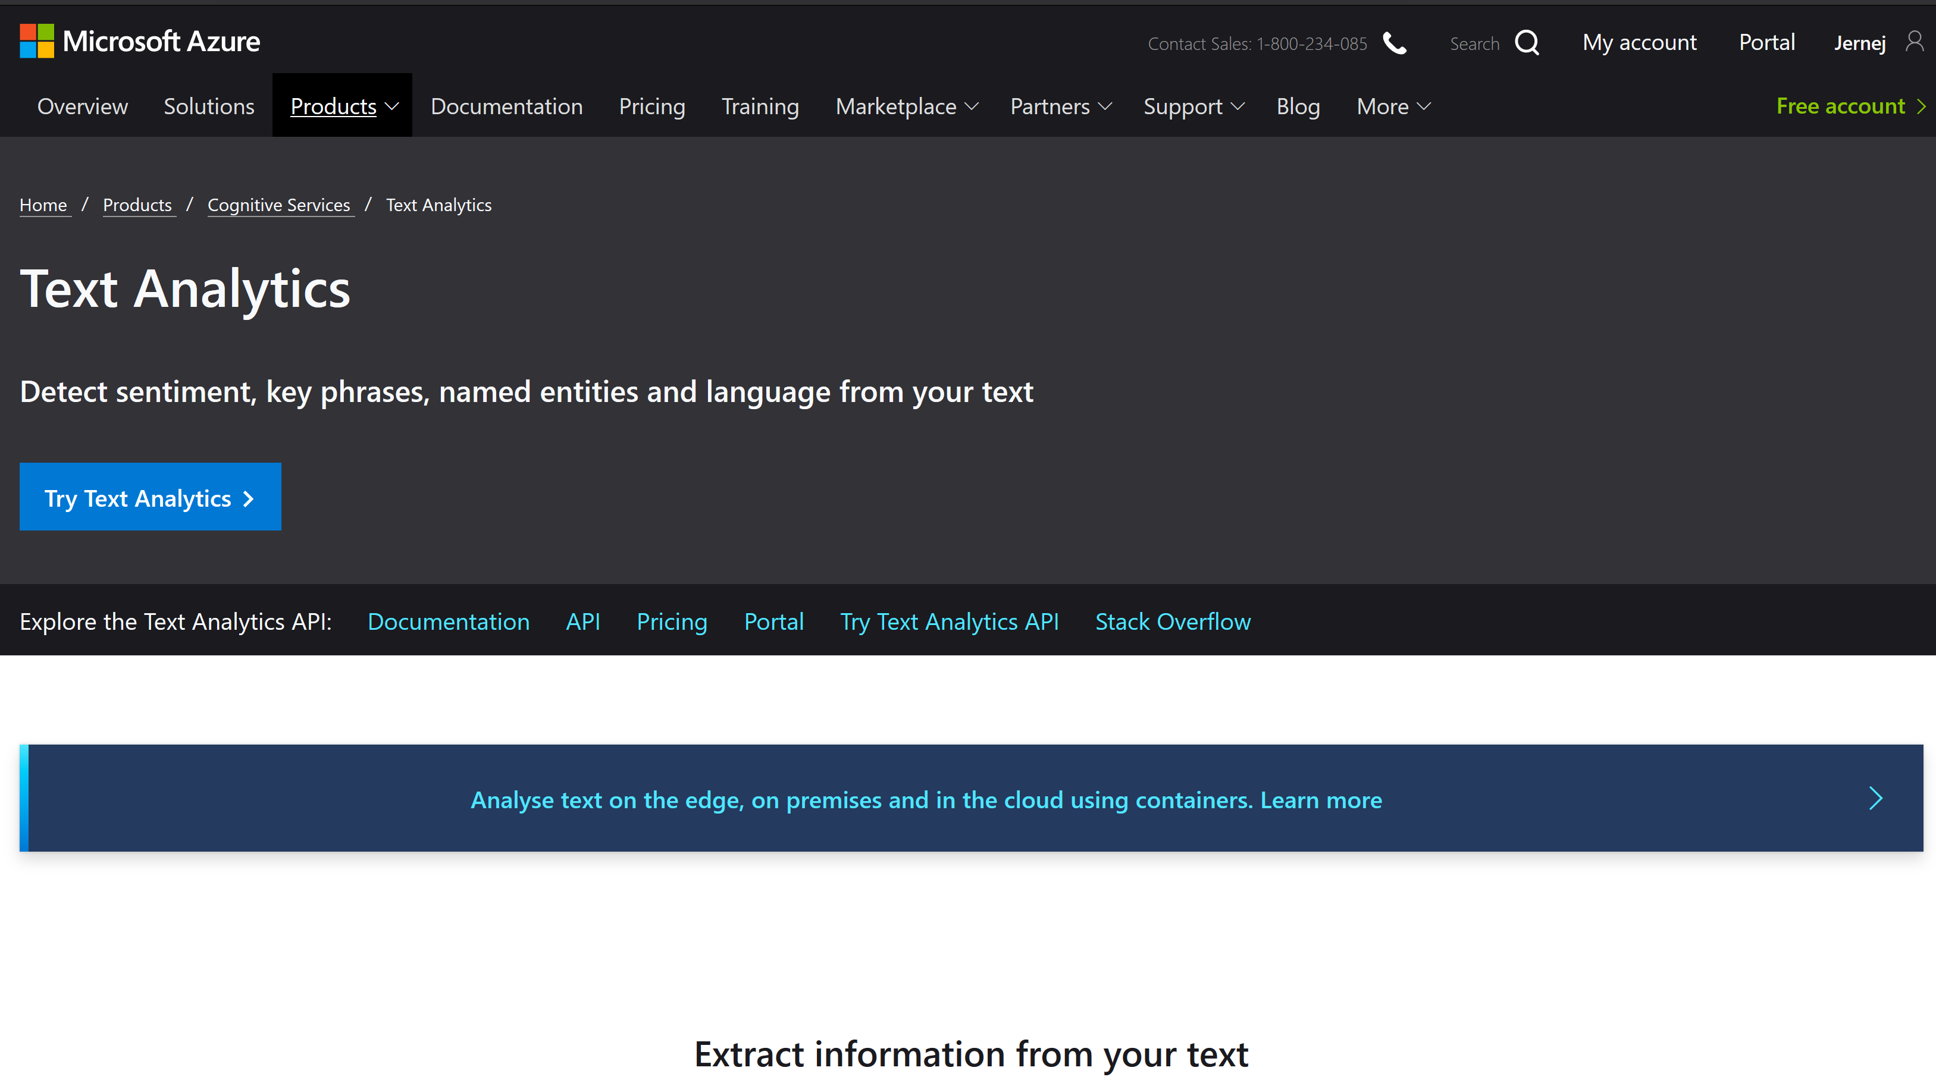
https://azure.microsoft.com/en-au/services/cognitive-services/text-analytics/

Slide 11
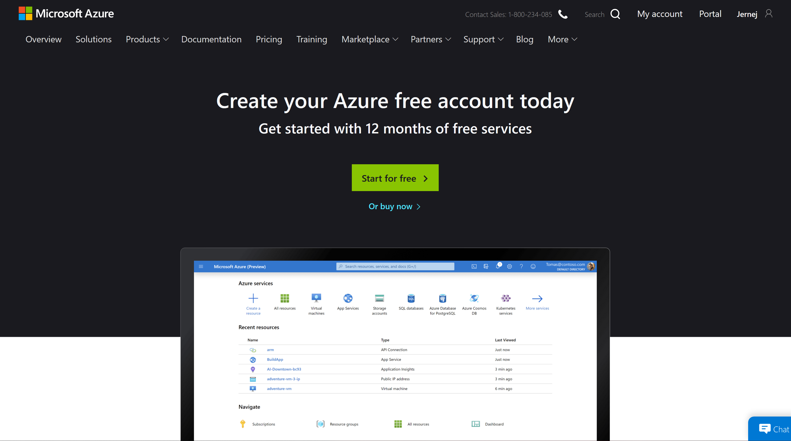
https://azure.microsoft.com/en-au/free/

Slide 12
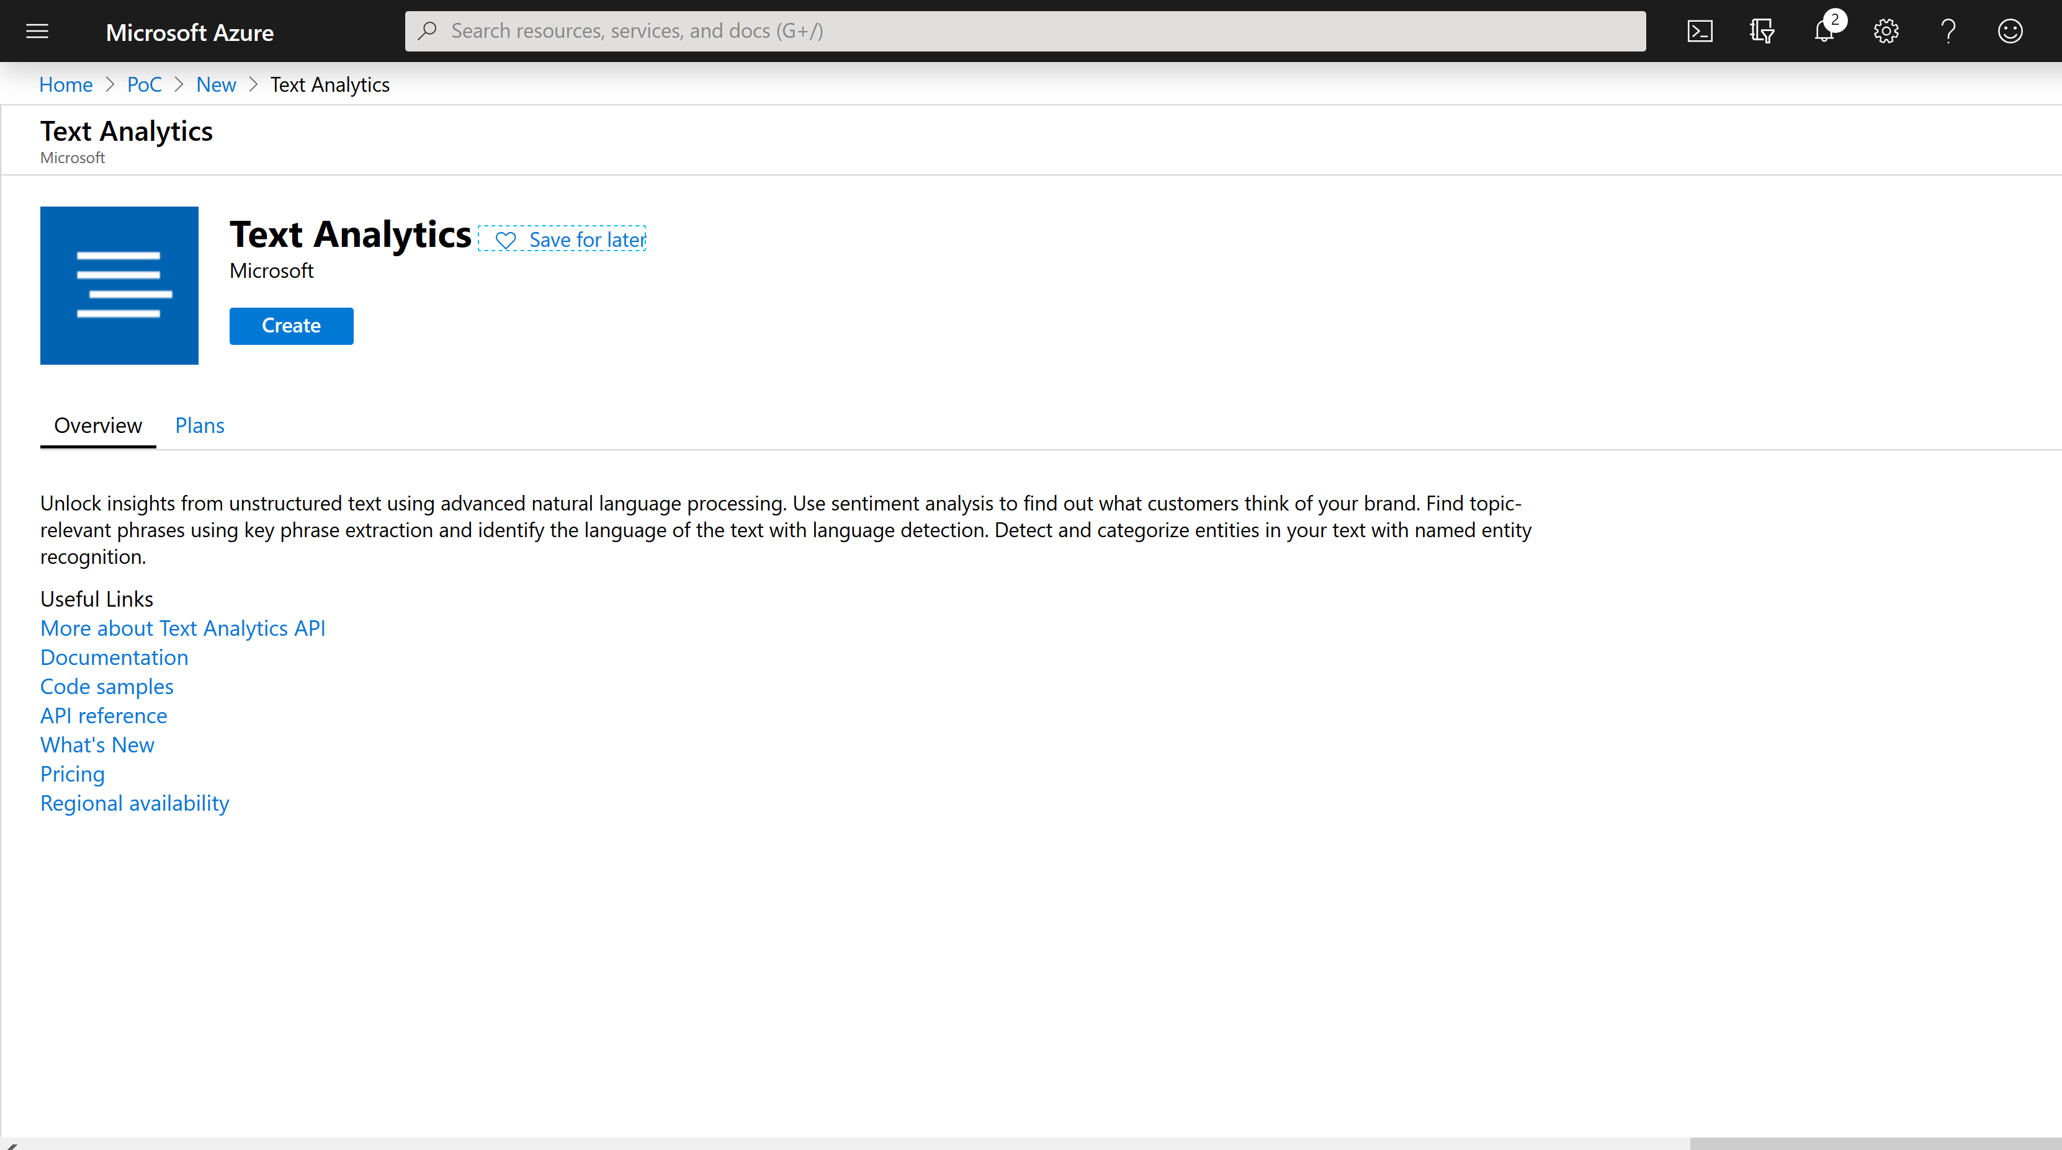
https://portal.azure.com

Slide 13
PowerShell – Create TextAnalytics
az cognitiveservices account create --kind TextAnalytics --location EastUS --name text-api-name --resource-group resource-group-name --sku F0 --yes
az cognitiveservices account keys list --name text-api-name --resource-group resource-group-name

Slide 14
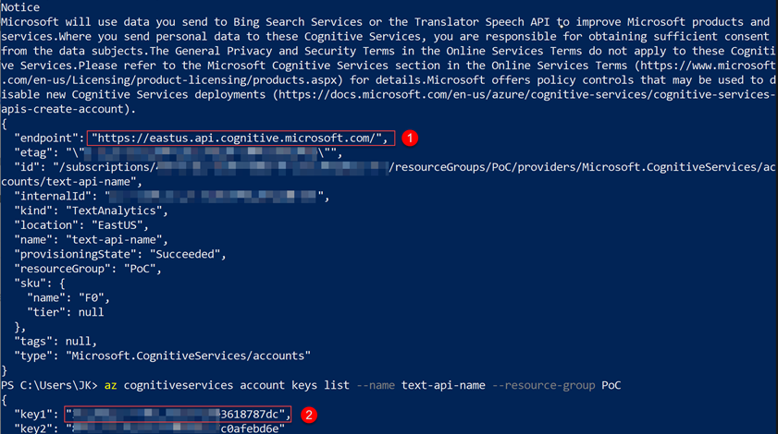

Slide 15
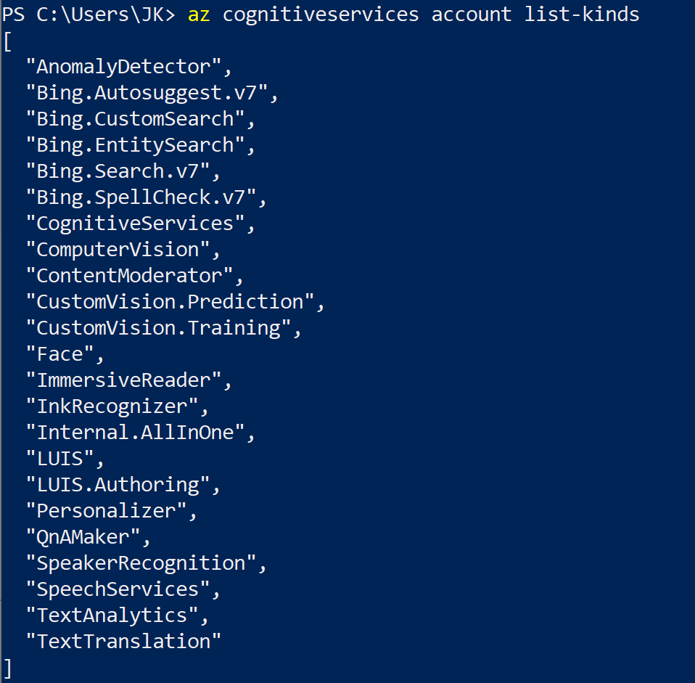
PowerShell – list all services
az cognitiveservices account list-kinds

Slide 16
Table of Contents
Cognitive Services
Get started
Demos

Slide 17
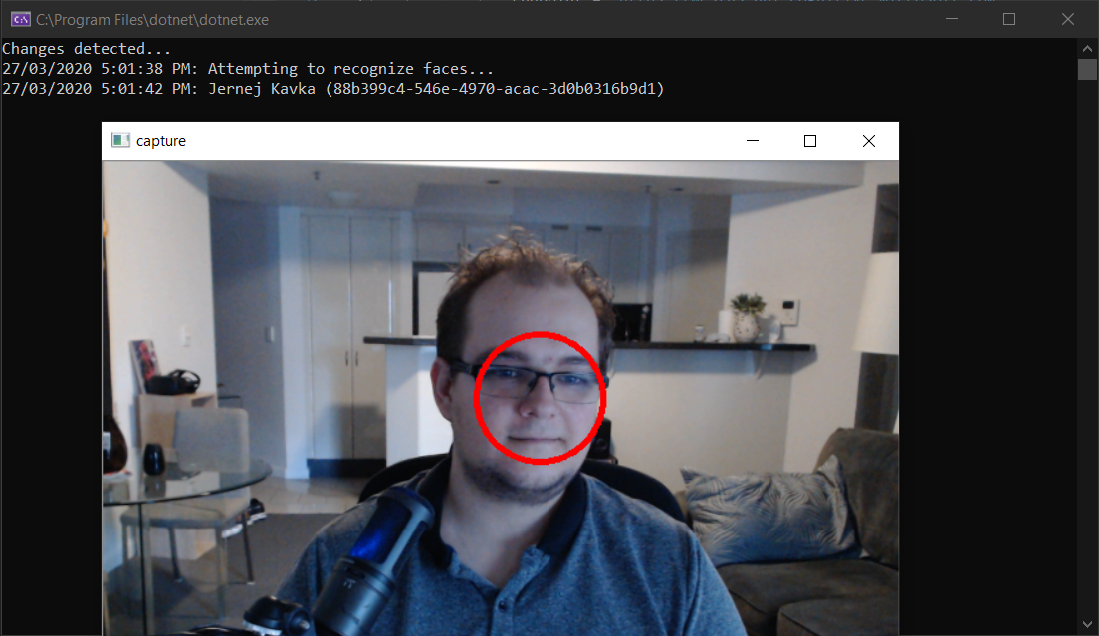
Facial recognition demo

Slide 18
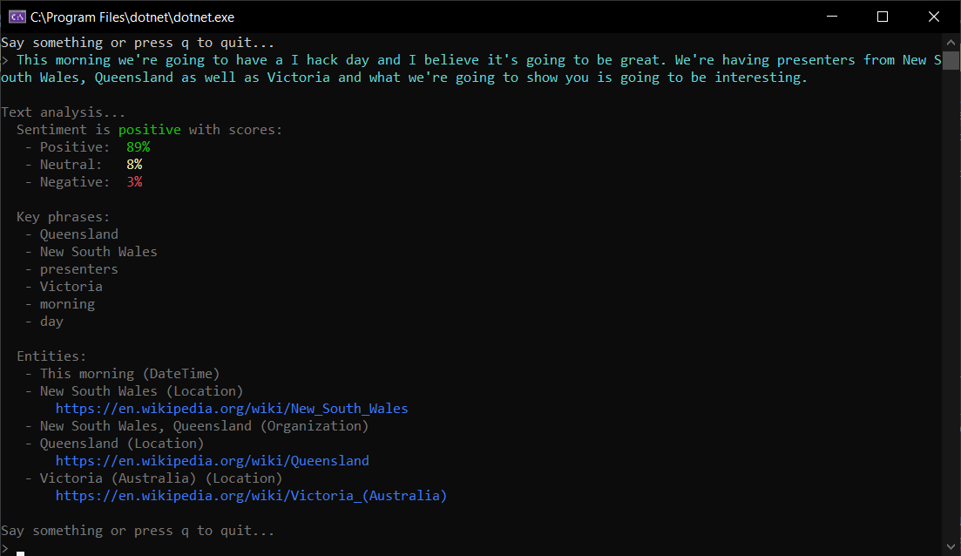
Call center demo

Slide 19
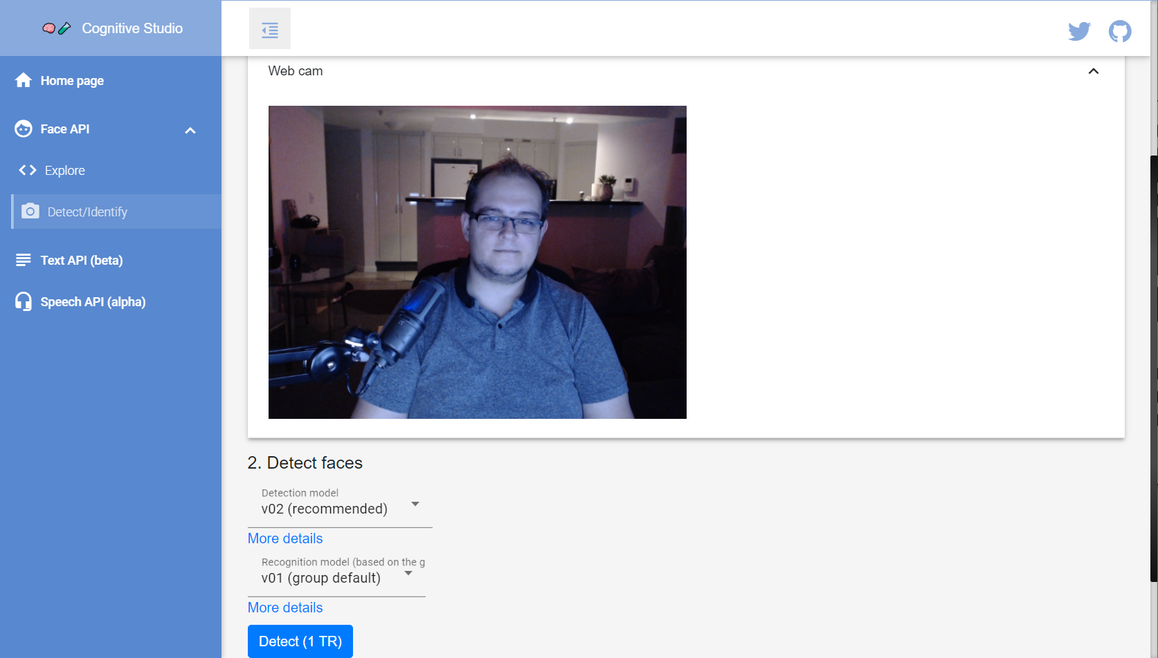
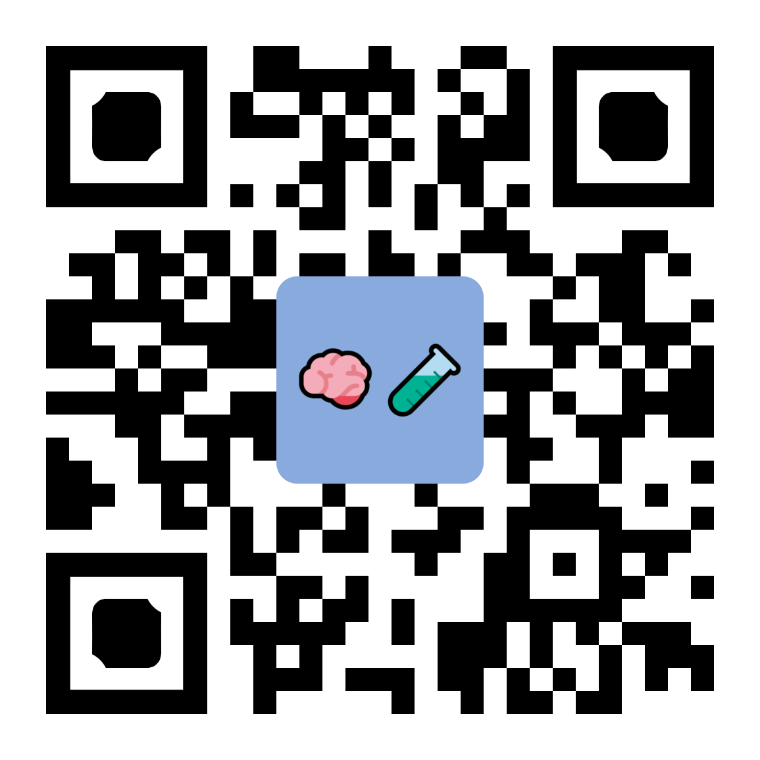
Cognitive Studio – cognitivestudio.dev

Slide 20
Thank you! https://jkdev.me @Jernej_kavka info@ssw.com.au www.ssw.com.au Sydney | Melbourne | Brisbane | Canberra | Gold Coast
Notes:
Additional resources:
https://towardsdatascience.com/what-are-the-types-of-machine-learning-e2b9e5d1756f
https://towardsdatascience.com/types-of-machine-learning-algorithms-you-should-know-953a08248861
https://discuss.datasciencedojo.com/t/101-machine-learning-algorithms-for-data-science-data-science-blog/702

Slide 21
Resources
Cognitive Services
https://azure.microsoft.com/en-au/services/cognitive-services/
Demos
https://github.com/jernejk?tab=repositories
https://jkdev.me/tag/ai/
Cognitive Studio
https://cognitivestudio.dev/

Slide 22

SSW Treasure Hunt
https://play.google.com/store/apps/details?id=com.ssw.consulting

